Slide 1
Deliver Value through Supply Chain Management, Channels of Distribution, and Logistics
Chapter Twelve

Slide 2
Chapter Objectives
Understand the concept of the value chain and the key elements in a supply chain
Explain what a distribution channel is and what functions distribution channels perform
Describe the types of wholesaling intermediaries found in distribution channels
Describe the types of distribution channels and how place fits in with the other three Ps in the marketing mix
Understand the steps to plan a distribution channel strategy
Explain logistics and how it fits into the supply chain concept
Define retailing; understand how retailing evolves and some ethical issues in retailing
Understand how we classify retailers
Describe the more common forms of nonstore retailing including B2C e-commerce
Understand the importance of store image to a retail positioning strategy and explain how a retailer can create a desirable image in the marketplace
Copyright © 2013 Pearson Canada Inc.
12-<number>
Notes:
p. 442

Slide 3
I. Understand the concept of the value chain and the key elements in a supply chain
Copyright © 2013 Pearson Canada Inc.
12-<number>
Notes:
This slide relates to Learning Objective (hereafter LO) #1 of chapter 12.

Slide 4
Place: The Final Frontier
Supply chain
All of the activities necessary to turn raw materials into a good or service and put it in the hands of the consumer
  Outsourcing is common
  Distribution channels are a subset of the supply chain
  Logistics management is the process of actually moving goods through the supply chain
Copyright © 2013 Pearson Canada Inc.
12-<number>
Notes:
This slide relates to LO #1 of chapter 12.
p. 442 - 443
LECTURE NOTES:
Walmart is a model of global supply chain effectiveness. They have been increasing the proportion of goods bought directly from manufacturers in order to lower their costs. They also maintain four global merchandising centers to service the 15 countries in which the chain operates. Walmart is frequently benchmarked by other firms attempting to improve the quality of their supply chain and logistics process.
Marketers have come to realize that the “place” aspect of marketing may be the only element that offers a real long-term competitive advantage. That’s why savvy marketers are always looking for novel way to distribute their products and develop effective supply chain strategies.
Efficiency in supply chain management means that firms often bring in outside companies to accomplish some of the activities that could otherwise be supplied in house which are necessary to turn raw materials into a good or service, and place it into the hands of the consumer. This is called outsourcing.

Slide 5
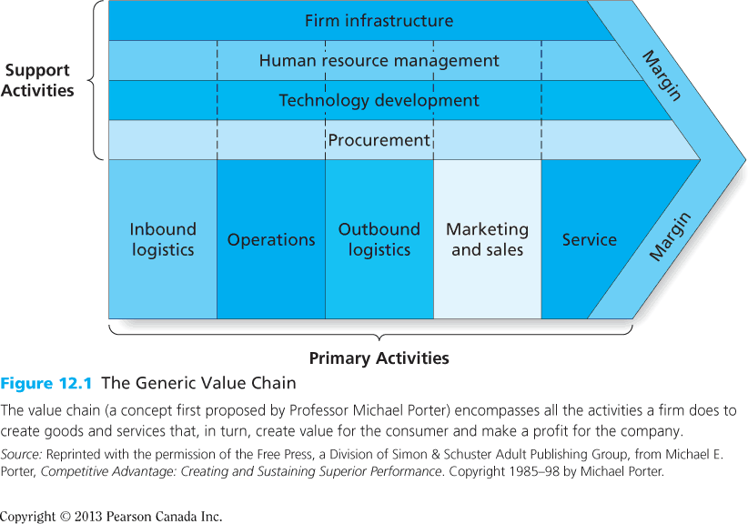
Figure 12.1
The Generic Value Chain
Copyright © 2013 Pearson Canada Inc.
12-<number>
Notes:
This slide relates to LO #1 of chapter 12.
p. 443
LECTURE NOTES:
The value chain consists of five primary activities (inbound logistics, operations, outbound logistics, marketing and sales, and service) and four support activities (procurement, technology development, human resource management, and firm infrastructure).

Slide 6
Links in the Supply Chain
Supply chain management
    The management of flows among firms in a supply chain to maximize total profitability
    Includes physical movement of and sharing of information about goods
  Insourcing
    A practice in which a
    company contracts with a specialist firm to handle all or part of its supply chain operations
Copyright © 2013 Pearson Canada Inc.
12-<number>
Notes:
This slide relates to LO #1 of chapter 12.
p. 444
LECTURE NOTES:
Flows managed within the supply chain include not only the physical movement but also the sharing of information about goods. For example, the need to share information about the procurement process and the marketing campaigns that will be executed which could influence demand.
One trend impacting global supply chain management is called insourcing. UPS is a great example of a firm that has benefited from this trend. UPS used to be considered “just” a package delivery service; today they specialize in insourcing, which means that many firms contract with UPS to run their essential operations. It may surprise you to know that insourcing services don’t stop at shipping. UPS employees fix laptops for their Toshiba clients and fills, bags, labels, and delivers orders for items bought from Nike.com
Insourcing differs from outsourcing in that outsourced processes are typically nonessential tasks that firms delegate to outside subcontractors.

Slide 7
Links in the Supply Chain (ctn’d)
Channel of distribution
    The series of firms or individuals that facilitates the movement of a product from producer to final customer
    Channel of distribution is part of the supply chain (see Figure 12.2)
Copyright © 2013 Pearson Canada Inc.
12-<number>
Notes:
This slide relates to LO #1 of chapter 12.
p. 445
LECTURE NOTES:
The difference between a supply chain and a channel of distributions rests in the number of members the functions that each performs. Supply chains are broader and as Figure 15.1 on the next slide demonstrates, consist of firms who supply raw materials, component parts, and supplies necessary to product the good or service, in addition to channels of distribution.

Slide 8
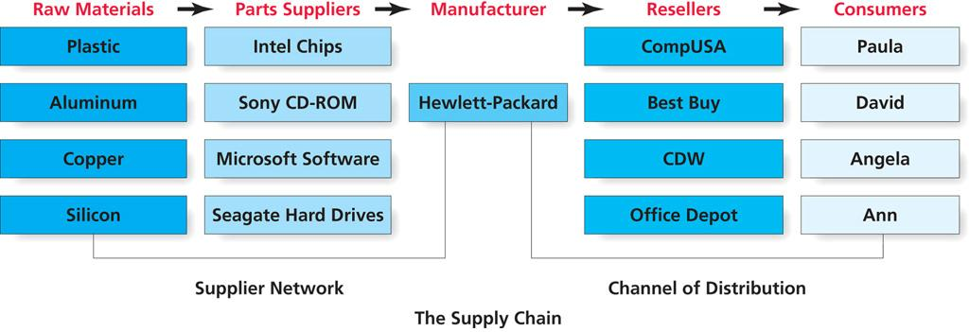
Figure 12.2
HP’s Supply Chain
Copyright © 2013 Pearson Canada Inc.
12-<number>
Notes:
This slide relates to LO #1 of chapter 12.
p. 444
LECTURE NOTES:
Figure 12.2 provides and example of a typical supply chain, in this case, that used by Hewlett-Packard.
The supplier network provides raw materials and parts to the manufacturer that are used in manufacturing laptops. Intel adds value to the laptop when it turns raw materials into branded chips. Intel and other parts suppliers ship parts to HP, who in turn combines these items and others to create a laptop.
The firm then contracts with resellers such as CompUSA, Best Buy, CDW and Office Depot to get the laptops to a retail setting where consumers such as Paula and David can buy the product.

Slide 9
II. Explain what a distribution channel is and what functions distribution channels perform
Copyright © 2013 Pearson Canada Inc.
12-<number>
Notes:
This slide relates to LO #2 of chapter 12.

Slide 10
Distribution Channels: Get It There
Distribution channels may be direct or indirect
  A direct channel consists of a producer and customers
  A indirect channel also includes channel intermediaries
    Channel intermediaries: Firms or individuals such as wholesalers, agents, brokers, and retailers who help move the product from the producer to the consumer or business user; also known as middlemen
Copyright © 2013 Pearson Canada Inc.
12-<number>
Notes:
This slide relates to LO #2 of chapter 12.
p. 445
LECTURE NOTES:
A channel of distribution consists of, at a minimum, a producer (or manufacturer/creator of a product or service), and a customer. This is the simplest for of distribution, called a direct channel.
Indirect channels contain one or more channel intermediaries who facilitate the movement of goods between the producer and the consumer or end user. Agents, wholesalers, distributors, and retailers are all examples of channel intermediaries.

Slide 11
Functions of Distribution Channels
Distribution channels
  Provide time, place, and ownership utility
  Provide logistics or physical distribution functions
  Create efficiencies by reducing the number of transactions
    Breaking bulk
    Creating assortments
    Facilitating functions
Copyright © 2013 Pearson Canada Inc.
12-<number>
Notes:
This slide relates to LO #2 of chapter 12.
p. 446 - 447
LECTURE NOTES:
Distribution channels and the various intermediaries used perform a number of distribution functions more efficiently and effectively than can any single organization.
Distribution channels provided time, place, and ownership utility, meaning that they make the products available when, where, and in the size/quantity that the customers desire.
Logistical and physical distributions functions provided by intermediaries increase the efficiency of the flow of goods to the consumer, making it easier, more convenient, and saving time. Just imagine if vegetables could only be purchased from farm stands, meat from butcher shops, bread from bakeries, and milk and cheese from diaries. One would have to spend their entire day flitting from place to place shopping for items that today can all be purchased in grocery stores.
The final key function of distribution channels is to reduce the number of transactions necessary for goods to flow between many different manufacturers and a large number of customers. Channel members create these efficiencies by breaking bulk, creating assortments, and performing facilitating functions.
Breaking bulk refers to the fact that wholesalers and retailers purchase large quantities of any given item – typically cases – from the manufacturer or distributor. Retailers break these cases down in the store and make it possible for consumers to purchase only one can of creamed corn (for example), instead of an entire case which may contain 12 or 24 cans.
Creating assortments means that channel intermediaries provide a variety of products in a single location at one time, thereby allowing consumers to do a “one-stop shop” when purchasing grocery items.
Facilitating functions refer to functions of channel intermediaries that make the purchase process easier for customers and manufacturers.

Slide 12
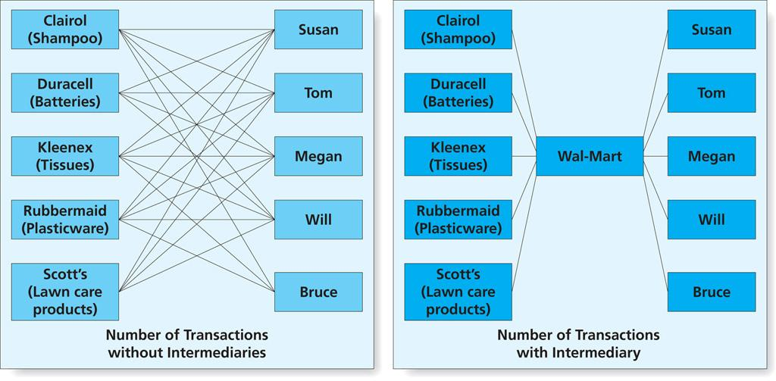
Figure 12.3
Reducing Transactions via Intermediaries
Copyright © 2013 Pearson Canada Inc.
12-<number>
Notes:
This slide relates to LO #2 of chapter 12.
p. 447
LECTURE NOTES:
Figure 12.3 demonstrates how distribution channels provide an assortment of products that customers can buy in the same location, thereby reducing the number of consumer transactions that are necessary and reducing the cost of obtaining a product.

Slide 13
The Internet in the
Distribution Channel
E-commerce creates radical changes in distribution strategies
  Disintermediation
    Eliminating some layers of the channel of distribution in order to cut costs and improve efficiency of the channel
  Knowledge management
    A comprehensive approach to collecting, organizing, storing, and retrieving a firm’s information assets
  Online distribution piracy can be problematic
Copyright © 2013 Pearson Canada Inc.
12-<number>
Notes:
This slide relates to LO #2 of chapter 12.
p. 448
LECTURE NOTES:
The Internet has evened the playing field for small firms with limited resources by making it possible for them to reach a national, if not international audience. While this is great news for entrepreneurs, e-commerce has radically impacted distribution strategies for a variety of goods and services.
Goods that are sold over the Internet allow manufacturers to reduce costs by eliminating many of the intermediaries traditionally found in offline channels of distribution, an outcome which has been called disintermediation. For example, airlines no longer need traditional travel agencies to book flights for consumers – consumers book their own flights either through online mega travel agencies such as Expedia, or directly from the airline’s website, eliminating the commission fee paid to booking agents.
Many companies use the Internet to make coordination among members of a supply chain more effective in ways that consumers never see. For example, the Internet allows firms to better implement knowledge management with respect to how they collect, organize, store, and retrieve information assets. Information assets can take many firms, including databases and the practical knowledge of employees within the organization. A firm can benefit from knowledge management practices when it allows for information assets to be shared with supply chain members to improve the speed of the flow of goods or address other problems.
Of course many products can actually use the Internet as the distribution mechanism, including software, electronic books, music, video, and more. Online piracy is still a major hurdle for those who would distribute products over the Internet. Piracy includes both outright theft and unauthorized repurposing of intellectual property via the Internet. Music piracy is rampant, as is piracy of online textbooks.

Slide 14
III. Describe the types of wholesaling intermediaries found in distribution channels
Copyright © 2013 Pearson Canada Inc.
12-<number>
Notes:
This slide relates to LO #3 of chapter 12.

Slide 15
Wholesaling Intermediaries
Are firms that handle the flow of products from the manufacturer to the retailer or business user
Independent intermediaries are not owned by manufacturers
  Merchant wholesalers
  Merchandise agents or brokers
Manufacturer-owned intermediaries
Copyright © 2013 Pearson Canada Inc.
12-<number>
Notes:
This slide relates to LO #3 of chapter 12.
p. 448 - 452

Slide 16
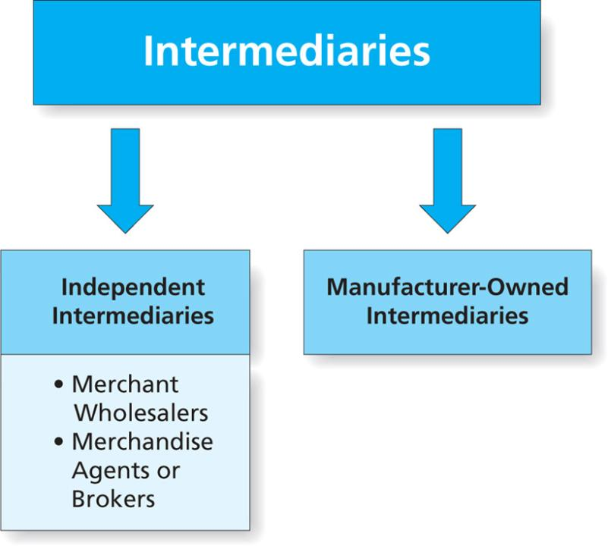
Figure 12.4
Key Types of Intermediaries
Copyright © 2013 Pearson Canada Inc.
12-<number>
Notes:
This slide relates to LO #3 of chapter 12.
p. 449
LECTURE NOTES:
Wholesaling intermediaries are firms that handle the flow of products from the manufacturer to the retailer/business user. Various forms exist:
Independent intermediaries do business with many different manufacturers and many different customer firms and thus help the flow of goods throughout the marketplace.
Merchant wholesalers are independent intermediaries that buy goods from manufacturers and sell to retailers and other B2B organizations. Because they take title to goods (meaning they take legal ownership of the items), they assume risk and can suffer financial losses if the products are damaged while in their possession, or if they become obsolete or just don’t sell. There are several forms of merchant wholesalers. We will discuss this on the next slide.

Slide 17
Independent Intermediaries
Merchant wholesalers buy goods from manufacturers (take title to them) and sell to retailers and other B2B customers
  Full-service merchant wholesalers
  Limited-service merchant wholesalers
    Cash-and-carry wholesalers
    Truck jobbers
    Drop shippers
    Mail-order wholesalers
    Rack jobbers
Copyright © 2013 Pearson Canada Inc.
12-<number>
Notes:
This slide relates to LO #3 of chapter 12.
p. 449 - 451

Slide 18
Independent Intermediaries (cnt’d)
Merchandise agents or brokers provide services in exchange for commissions but never take title to the product
  Agents serve clients on a ongoing basis while brokers serve clients for a short period of time
    Manufacturers’ agents, or manufacturers’ reps
    Selling agents
    Commission merchants
    Merchandise brokers
Copyright © 2013 Pearson Canada Inc.
12-<number>
Notes:
This slide relates to LO #3 of chapter 12.
p. 451

Slide 19
Manufacturer-Owned Intermediaries
Manufacturers sometimes set up their own channel intermediaries to maintain complete control over the channel
    Sales branches
    Sales offices
    Manufacturers’ showrooms
Copyright © 2013 Pearson Canada Inc.
12-<number>
Notes:
This slide relates to LO #3 of chapter 12.
p. 451 - 452

Slide 20
IV. Describe the types of distribution channels and how place fits in with the other three Ps in the marketing mix
Copyright © 2013 Pearson Canada Inc.
12-<number>
Notes:
This slide relates to LO #4 of chapter 12.

Slide 21
Types of Distribution Channels
Consumer Channels
  Why use direct channel
    Make it quicker to ship the product to the consumer
    Producer keep price low by getting rid of middlemen markup
    Producer exert more control over the transaction
  Why use indirect channel
    Consumers familiar with certain intermediaries
    Channel members create utility and transaction efficiencies
Copyright © 2013 Pearson Canada Inc.
12-<number>
Notes:
This slide relates to LO #4 of chapter 12.
p. 453 - 454

Slide 22
BAB235 – In-class Activity
Assume that you are the director of marketing for a firm that manufactures cleaning chemicals used in industries.
You have traditionally sold these products through manufacturer’s reps. You are considering adding a direct Internet channel to your distribution strategy, but you aren’t sure whether this will create channel conflict. In groups make a list of the pros and cons of this move. What do you think is the best decision?
Copyright © 2013 Pearson Canada Inc.
15-<number>

Slide 23
Types of Distribution Channels (ctn’d)
Business-to-business channels may be direct or indirect
  Direct channels are more common to B2B markets than to consumer markets
A hybrid marketing system uses a number of different channels and communication to serve a target market
Copyright © 2013 Pearson Canada Inc.
12-<number>
Notes:
This slide relates to LO #4 of chapter 12.
p. 454 - 455

Slide 24
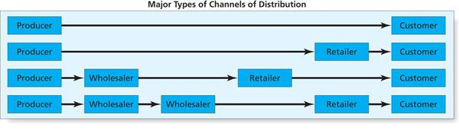
Figure 12.5
Different Types of Channels of Distribution
Copyright © 2013 Pearson Canada Inc.
12-<number>
Notes:
This slide relates to LO #4 of chapter 12.
p. 453
LECTURE NOTES:
Firms face a number of choices when the structure or restructure their distribution channels. Marketers first consider the different channel levels that are available. Channel levels refer to the number of distinct categories of intermediaries that populate a channel of distribution. Considerations of which members are available, the size of the market, and the frequency of consumer product purchases are just some of the factors considered at this point. Figure 12.5 summarizes the different structures that a channel of distribution can take. The first portion of this figure is illustrated on this slide. We’ll discuss the remaining sections on subsequent slides.
A direct channel is illustrated on the first line, in which a producer sells directly to the customer, be it a business or consumer.
When this tactic is not feasible, retailers, wholesalers, or even multiple wholesalers may be added to the distribution channel. But as each intermediary is added to the channel structure, the final cost to the customer increases.

Slide 25
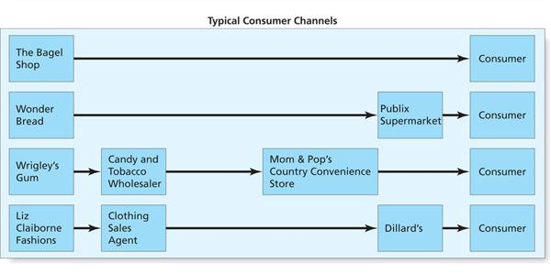
Figure 12.5 (ctn’d)
Different Types of Channels of Distribution
Copyright © 2013 Pearson Canada Inc.
12-<number>
Notes:
This slide relates to LO #4 of chapter 12.
p. 453
LECTURE NOTES:
As previously explained, consumer channels of distributions can take a variety of forms, including direct from the producer to the consumer, or one which includes one or more wholesalers and retailers.
Direct channels often allow producers to serve customers better and at a lower cost. Sometimes this is the only option because using intermediaries may inflate the final price to the consumer beyond what he or she is willing to pay. Direct channels also provide manufacturers with more control over the pricing, service, and delivery process. Working directly with consumers may also provide valuable insights into trends, needs, complaints, and the effectiveness of various marketing strategies.
Producers are often forced to use indirect channels to reach consumers at the places they prefer to shop and expect to find merchandise of certain types. The producer-retailer-consumer channel creates utility and transaction efficiencies, channel members enhance the ability of producers to reach customers.
The producer-wholesaler-retailer-consumer-channel is very common in consumer marketing such as ice cream, as well as fashion products.

Slide 26
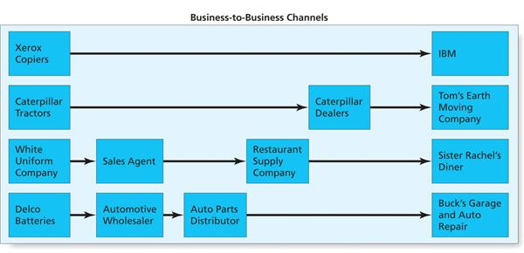
Figure 12.5 (ctn’d)
Different Types of Channels of Distribution
Copyright © 2013 Pearson Canada Inc.
12-<number>
Notes:
This slide relates to LO #4 of chapter 12.
p. 453
LECTURE NOTES:
Business-to-business channels operate in a similar manner. Some manufacturers sell directly to the end business users. Others use dealers as intermediaries. Longer channels may involve sales agents and wholesalers, or wholesalers and distributors. In the B2B context, the merchant wholesaler is typically referred to as an industrial distributor.
It’s not uncommon for a producer to participate in more than one type of channel, regardless of whether consumers or businesses are ultimately targeted. Using multiple channels is called dual distribution or a multiple distribution system.
For example, drug companies sell to at least three types of channels – direct to hospitals and clinics, and indirect to consumers via drug stores and retailers. Alternately, a drug provider may sell some OTC medicines to wholesalers, who in turn sell to retailers, who then make the product available to the final consumer.
Often companies combine channels, direct sales, distributors, retail sales, and direct mail to reach a target market. This combination of different channels and communication methods is called a hybrid marketing system.

Slide 27
Distribution Channels and the Marketing Mix, Ethics in the Distribution Channel
Distribution decisions interact with the other 3 Ps in a number of ways
  Place decisions influence pricing
  Distribution decisions can help develop a position in the market
  Nature of the product influences choice of distribution channels, especially retailers
Distribution decisions can create ethical dilemmas
  Slotting allowances
  Size of channel intermediaries
Copyright © 2013 Pearson Canada Inc.
12-<number>
Notes:
This slide relates to LO #4 of chapter 12.
p. 455 – 456
LECTURE NOTES:
Distribution decisions affect pricing – the more intermediaries involved, the higher the price will be to the ultimate buyer. The nature of the intermediaries selected also influences pricing. Low-priced retailers such Walmart are expected to carry lower costing merchandise than are higher end retail stores.
Our choice of distributors is often heavily influenced by the nature of the product itself. Brand sold on the basis of a prestige and status are obviously not going to be distributed through mass merchandise outlets, but rather should be found in specialty stores.
Distribution decisions also influence the position of the product in its market. Enterprise rental cars decision to open retail outlets in primarily residential areas and local business centers to service those that need a car while a personal vehicle is being repaired, and has allowed it to avoid the cutthroat focus on price associated with many rental agencies that primarily use airport locations for their service offering locations.
Distribution decisions can create ethical dilemmas as well. As mentioned earlier when discussing trade promotions, slotting allowances are often charged by retailers in exchange for allowing a manufacturer to place the product on the retailer’s shelf. Is this ethical? Many believe it’s prejudicial to small manufacturer’s who can’t afford to pay the fees.
Another ethical issue relates to the size of a channel intermediary – the larger the intermediary, the more power they have within the supply chain. Walmart has been criticized for forcing smaller retailers out of business (who can’t compete on the basis of price due to Walmart’s incredible discounts garnered via economies of scale) and for forcing others in the supply chain to make severe concessions in order to do business with the firm. Walmart has responded to some criticisms, and now offers financial grants to hardware stores, dress shops, and bakeries near its urban locations which help train these stores how to survive with a Walmart in town.

Slide 28
V. Understand the steps to plan a distribution channel strategy
Copyright © 2013 Pearson Canada Inc.
12-<number>
Notes:
This slide relates to LO #5 of chapter 12.

Slide 29
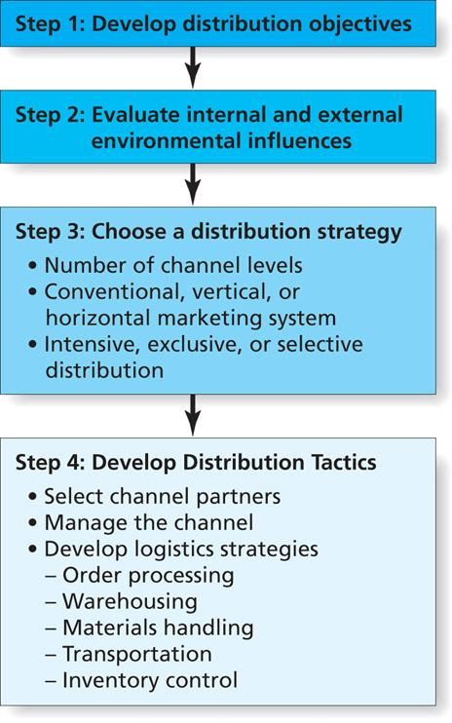
Figure 12.6
Steps in Distribution Planning
Copyright © 2013 Pearson Canada Inc.
12-<number>
Notes:
This slide relates to LO #5 of chapter 12.
p. 457
LECTURE NOTES:
Planning a channel strategy works best when marketers follow the steps shown in Figure 12.6
The first step requires that objectives be developed for the distribution plan that support the firm’s overall marketing goals. This requires consideration of how distribution can work with the other marketing mix elements to increase profits, market share, or perhaps sales. More specific objectives may depend upon the nature of the product. If the product is heavy or bulky, the key goal may be to minimize shipping costs. On the other hand, if the product is marketed on the basis of status or prestige, the goal may be choose retailers who provide the level of store service and merchandise mix that is consistent with supporting the product’s desired image.
In the second step, marketers consider both the internal and external environmental influences and how these factors can be used or minimized to develop the best channel structure. For example, is intensive, selective, or exclusive distribution most appropriate? Does the B2B product being sold require high levels of technical know-how and customer service? If so, a direct channel would likely be best. Is the item perishable? If so, a short channel would be better while inexpensive, standardized consumer goods requiring intensive distribution would likely benefit from a longer channel.
The firm’s ability to handle distribution functions, the channel intermediaries which are available, and how the competition distributes
its products are also considered. Should the firm use the same retailers as its competitors? Some products are better sold in dedicated outlets that feature no competitive brands (e.g., Harley-Davidson dealers). In other instances, consumers expect competitive products to be side by side within the same retail store. Marketer’s also review competitive distribution strategies to learn from their success and failures.

Slide 30
Transportation
Transportation modes differ in their
  Dependability
  Cost
  Speed of delivery
  Accessibility
  Capability
  Traceability
Transportation modes
  Railroads
  Water
  Trucks
  Air
  Pipeline
  The internet
Copyright © 2013 Pearson Canada Inc.
12-<number>
Notes:
slide relates to LO #6 of chapter 12.
p. 464 - 466
LECTURE NOTES:
Logistics decisions must take into account options for transportation. Dependability refers to the ability of the carrier to deliver goods safely and on time.
Cost refers to the total transportation costs to move a product from one location to another, including any charges for loading, unloading, and in-transit storage.
Speed of delivery means the total time to move a product from one location to another, including loading and unloading.
Accessibility relates to the number of different locations the carrier serves.
Capability refers to a carriers ability to handle a variety of different products such as large or small, fragile, or bulky.
Traceability relates to the ability of the carrier to locate goods in a shipment.

Slide 31
BAB235 CH12 –In-class Activity
Suppose you are responsible for shipping the following goods to the appointed destinations.
What shipping methods would you choose and why?
Parakeets Ship from Vancouver, B.C. to Winnipeg, Manitoba
Oil Ship from Alberta to Quebec
Modular Homes Ship from Moncton, New Brunswick to Saint John’s Newfoundland
Steel Ship from Hamilton, Ontario to Yellowknife, N.W.T.
Toys Ship from Truro, Nova Scotia to Summerside, P.E.I.
Copyright © 2013 Pearson Canada Inc.
15-<number>

Slide 32
Plan a Channel Strategy
Step 3: Choose a distribution strategy
  Number of channel levels
  Type of system
    Conventional marketing systems: members work independently of one another, and their interactions are limited to simply buying and selling from one another
    Vertical marketing systems: channels in which there is a formal cooperation among channel members at two or more different levels
      Administered, corporate, contractual
    Horizontal marketing system: two or more firms at the same channel level who agree to work together to get their product to the customer
  Level of distribution intensity
    Intensive, exclusive, or selective distribution
Copyright © 2013 Pearson Canada Inc.
12-<number>
Notes:
This slide relates to LO #5 of chapter 12.
p. 457 - 460
LECTURE NOTES:
The third step in this process requires that marketers make at least three decisions related to their distribution strategy: the number of levels to be used, whether a conventional, vertical or horizontal marketing system is most appropriate, and whether intensive, selective or exclusive distribution will be used.
We’ve already talked about factors that influence the choice of the number of distribution levels, so let’s focus next on whether conventional, vertical, or horizontal marketing systems should be chosen.
In a conventional marketing system, members work independently of one another, and their interactions are limited to simply buying and selling from one another. Each firm seeks to maximize its own profit or minimize it costs, though channel members realize that to succeed they must treat each other fairly. Conventional marketing systems are often highly successful.
Vertical marketing system (VMS) are channels in which there is a formal cooperation among channel members at two or more different levels: manufacturing, wholesaling, or retailing. VMS are helpful when the goal is to reduce costs associated with channel activities, and another benefit is that VMS provide a level of cooperation and efficiency that is simply not possible with a conventional system. For example, members share information and provide services to each other. Three types of vertical systems exist.
Administered VMS have members that remain independent but work together voluntarily because of the power of single channel member.
In a corporate VMS, a single firm owns the manufacturing, wholesaling, and retailing operations.
Contractual VMS enforce member cooperation by contracts that spell out the responsibilities of each party and the terms of cooperation. A few examples include wholesaler-sponsored VMS, in which a wholesaler gets retailers to work together and use a common name, cooperate in advertising, etc., such as IGA and Ace Hardware stores. Retailers also form their own cooperative to establish a wholesaling operation that helps them compete more efficiently with larger chain stores. Finally, franchise systems are a third type of contractual VMS in which a franchiser, such as McDonald’s, allows an entrepreneur to use the corporate name and marketing materials for a hefty fee.
Horizontal marketing systems feature two or more firms at the same channel level who agree to work together to get their product to the customer.

Slide 33
Plan a Channel Strategy (ctn’d)
Step 4: Develop distribution tactics
  Select channel partners
    Normally a long-term commitment
  Manage the channel
    Channel leader/captain
    Dominant firm that controls the channel (via economic, legitimate, reward or coercive power)
Copyright © 2013 Pearson Canada Inc.
12-<number>
Notes:
This slide relates to LO #5 of chapter 12.
p. 460 - 462
LECTURE NOTES:
The final step in the distribution planning process is to develop the distribution tactics needed to implement the plan, including the selection of which individual channel members should be used and in what capacity.
The tactics developed will have a direct impact on customer satisfaction.
Channel relationships are normally long-term commitments, so the selection of channel members is crucial to the long-term success of the firm as mistakes can be quite costly. Factors considered include the ability of a firm to contribute to profitability, and to provide the type of service needed by customers. Often it is important to use channel partners similar to those used by the competition, particularly when consumers expect to the see items together on the retailer’s shelf. Dedication to social responsibility may also influence the selection of channel partners by giving preference to minority-owned channel members.
Managing the channel requires selection of a channel leader or captain, a firm at one distribution level that takes a leadership role by establishing operating norms and processes on its power relative to other channel members. Firms who become channel leaders do so because they have power of some type over the other channel members.
Economic power occurs when the firm has the ability control resources
Legitimate power occurs when a channel member has legal authority to call the shots, such as in a franchisor relationship.
Reward or coercive power occurs when a producer firm has the ability to give profitable products or take them away from channel members.

Slide 34
VI. Explain logistics and how it fits into the supply chain concept
Copyright © 2013 Pearson Canada Inc.
12-<number>
Notes:
This slide relates to LO #6 of chapter 12.

Slide 35
Logistics:
Implement the Supply Chain
Logistics
    The process of designing, managing, and improving the movement of products through the supply chain
    It includes purchasing, manufacturing, storage, and transport
Logistics inbound to the firm and outbound from the firm
Reverse logistics is increasingly important
Copyright © 2013 Pearson Canada Inc.
12-<number>
Notes:
slide relates to LO #6 of chapter 12.
p. 462
LECTURE NOTES:
Marketing success rests strongly on implementation. That’s why marketers place a great deal of emphasis on logistics. Inbound logistics take place with respect to the raw materials, parts, components, and supplies that are needed for the manufacturing process, while outbound logistics stem from the firm and move the finished goods or works-in-process out through the distribution channel.
Recycling, material reuse, product returns, and waste disposal – called reverse logistics – are becoming increasingly important as firms consider sustainability as a competitive advantage and continue to devote resources to encourage sustainable practices.

Slide 36
Logistics:
Implement the Supply Chain (ctn’d)
Physical distribution
    The activities that move finished goods from manufacturers to final customers, including order processing, warehousing, materials handing, transportation, and inventory control.
Copyright © 2013 Pearson Canada Inc.
12-<number>
Notes:
slide relates to LO #6 of chapter 12.
p. 463
LECTURE NOTES:
Logistics attempts to deliver exactly what the customer wants at the right place, the right time, and the right prices. Physical distribution activities are essential to performing this task, and effective physical distribution is at the core of suggestive logistics.
While cost minimization is an important part of this process, forward-thinking firms consider the needs of the customer first and make certain that the customer’s goals become their goals. This means firms must trade-off between low costs and high customer service. Thus the appropriate goal is to deliver what the market needs at the lowest possible cost as long as the firm can meet delivery requirements.

Slide 37
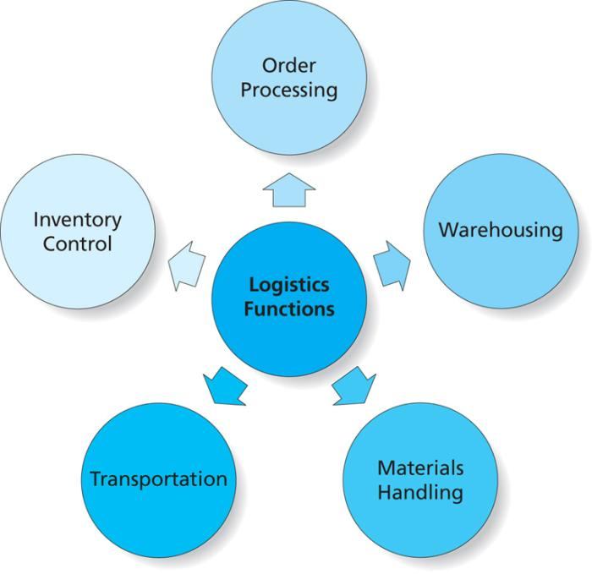
Figure 12.7
The Five Functions of Logistics
Copyright © 2013 Pearson Canada Inc.
12-<number>
Notes:
slide relates to LO #6 of chapter 12.
p. 463
LECTURE NOTES:
Developing logistic strategies requires marketers to make decisions related to the five functions of decisions displayed in Figure 12.7.
Order processing includes the series of activities that occurs between the time an order comes into the organization and the time the product goes out the door. Many firms automate this process with enterprise resource planning systems, which are software systems that integrate information from across the entire company, including finance, order fulfillment, manufacturing, and transportation and then facilitates sharing of the data throughout the firm. For example, and ERP system ties information on product inventories to sales information so that a sales representative can tell a customer whether or not a product is in stock.
Warehousing involves the storage of goods in anticipation of the sale or transfer to of goods to another member of the channel of distribution. It’s the warehousing function of logistics that allows marketers to provide time utility to consumers by holding products until the consumer is ready to buy. Logistics planning requires determining how many warehouses will be needed, where they should be located, and what type they should be. Higher desired customer service levels may require more warehouses to minimize shipping times. Location is also chosen on the basis of proximity to railroads, seaports, or major highways. Private warehouses are owned by the firm and require a large initial investment, though they lose less product due to damage. Public warehouses allow a firm to rent a portion of a warehouse, thereby minimizing costs. Distribution centers may store goods for a short time, but then serve other functions such as breaking bulk.
Materials handling is the moving products into, within, and out of warehouses. Procedures that limit the number of times a product must be handled decrease the likelihood of damage and reduce the cost of materials handling.
The final two functions of logistics will be discussed on the remaining slides.

Slide 38
Order processing
  Includes the series of activities that occurs between the time an order comes into the organization and the time the product goes out the door.
  Many firms automate this process with enterprise resource planning systems, which are software systems that integrate information from across the entire company, including finance, order fulfillment, manufacturing, and transportation and then facilitates sharing of the data throughout the firm. For example, and ERP system ties information on product inventories to sales information so that a sales representative can tell a customer whether or not a product is in stock.
Copyright © 2013 Pearson Canada Inc.
15-<number>

Slide 39
Warehousing
  Involves the storage of goods in anticipation of the sale or transfer to of goods to another member of the channel of distribution. It’s the warehousing function of logistics that allows marketers to provide time utility to consumers by holding products until the consumer is ready to buy.
  Logistics planning requires determining how many warehouses will be needed, where they should be located, and what type they should be.
Copyright © 2013 Pearson Canada Inc.
15-<number>

Slide 40
Higher desired customer service levels may require more warehouses to minimize shipping times. Location is also chosen on the basis of proximity to railroads, seaports, or major highways. Private warehouses are owned by the firm and require a large initial investment, though they lose less product due to damage. Public warehouses allow a firm to rent a portion of a warehouse, thereby minimizing costs. Distribution centers may store goods for a short time, but then serve other functions such as breaking bulk
Copyright © 2013 Pearson Canada Inc.
15-<number>

Slide 41
Transportation
Copyright © 2013 Pearson Canada Inc.
15-<number>

Slide 42
Factor that determines the mode of transportation
Dependability :refers to the ability of the carrier to deliver goods safely and on time.
Cost: refers to the total transportation costs to move a product from one location to another, including any charges for loading, unloading, and in-transit storage.
Speed of delivery: means the total time to move a product from one location to another, including loading and unloading.
Accessibility: relates to the number of different locations the carrier serves
Capability: refers to a carriers ability to handle a variety of different products such as large or small, fragile, or bulky.
Traceability: relates to the ability of the carrier to locate goods in a shipment.
Copyright © 2013 Pearson Canada Inc.
15-<number>

Slide 43
Materials handling
  Materials handling is the moving of products into, within, and out of warehouses
  Procedures that limit the number of times a product must be handled decrease the likelihood of damage and reduce the cost of materials handling
Copyright © 2013 Pearson Canada Inc.
15-<number>

Slide 44
Inventory Control:
JIT, RFID, and Fast Fashion
Inventory control
    Activities to ensure that goods are always available to meet customers’ demands
    Firms work hard to track their merchandise so they know where goods are and can easily get them where needed when low-inventory situations occur
Copyright © 2013 Pearson Canada Inc.
12-<number>
Notes:
slide relates to LO #6 of chapter 12.
p. 466
LECTURE NOTES:
Inventory control is the final function of logistics. Firms work hard to track their merchandise so they know where goods are and can easily get them where needed when low-inventory situations occur.
Some firms use radio frequency ID technology to tag clothes or virtually any product that can contain tiny chips of this nature. RFID tags contain information about the item’s content, origin, destination, etc. Some consumer groups are creating a backlash against RFID in blogs or via other sources, labeling them “spy chips”. In extreme cases, boycotts and other anti-company initiatives have been instigated.
Firms store goods for many reasons. With seasonal items, for example, it is often more economical to produce goods year round, inventory excess product, and then ship it when needed. Retailers may also find that money can be saved by ordering larger quantities and reducing the number of deliveries. Of course the downside is that stockouts can occur when demand exceeds estimations and inadequate product is on hand to be sold. While often a mere inconvenience for consumers, other forms of stockouts – such as an inadequate supply of anti-venom – could be life threatening to patients in need.
Total costs are heavily influenced by logistics. Poor planning could lead to expensive emergency deliveries or lost customers. On the other hand, too much inventory leads to excessive carrying costs and the possibility of lost product due to perishability or damage.
Just in time delivery systems are used to set up the delivery of goods just as they are needed on the production floor, minimizing inventory costs while ensuring that inventory will be there when needed.
A supplier’s ability to make on-time deliveries is the single most critical factors in the selection factor, even more important than price. Often suppliers agree to set-up production facilities close to large customers to guarantee JIT delivery.

Slide 45
  Radio frequency identification (RFID)
    Product tags with tiny chips containing information about the item’s content, origin, and destination
  Just in time (JIT)
    Inventory management and purchasing processes used to reduce inventory to very low levels and ensure that deliveries from suppliers arrive only when needed
Copyright © 2013 Pearson Canada Inc.
15-<number>

Slide 46
Supply Chain Metrics
Common supply chain metrics
  On-time delivery
  Forecast accuracy
  Value-added productivity per employee
  Returns processed as a percentage of product revenue
  Customer order actual cycle time
  Perfect order measurement
Copyright © 2013 Pearson Canada Inc.
12-<number>
Notes:
slide relates to LO #6 of chapter 12.
p. 467
LECTURE NOTES:
Supply chain metrics include the items shown on this slide. While most are self-explanatory, the last requires a bit of discussion.

Slide 47
Supply Chain Metrics (ctn’d)
Perfect order measurement
  Suppose the following error rates are identified
    Order rate accuracy = 99.95%
    Warehouse pick accuracy = 99.2%
    On-time delivery = 96%
    Shipped without damage = 99%
    Invoiced correctly = 99.8%
    Overall perfect order measurement =
    99.95 * 99.2 * 96 * 99 * 99.8 = 94.04%
Copyright © 2013 Pearson Canada Inc.
12-<number>
Notes:
slide relates to LO #6 of chapter 12.
p. 467
LECTURE NOTES:
Perfect order measurement calculates the error-free rate of each stage of a purchase order. This measure helps managers to pinpoint exactly where a process needs to be improved. The error rates of each stage can also be multiplied by each other to determine an overall error rate, or the “perfect order measurement”.

Slide 48
VII. Define retailing; understand how retailing evolves and some ethical issues in retailing
Copyright © 2013 Pearson Canada Inc.
12-<number>
Notes:
This slide relates to LO #7 of chapter 12.

Slide 49
Retailing: Special Delivery
Retailing
  The final stop in the distribution channel in which organizations sell goods and services to consumers for their personal use
Retailers
  Belong to a channel of distribution
  Provide time, place, and ownership utility to customers
  Retailing is different around the globe
Copyright © 2013 Pearson Canada Inc.
12-<number>
Notes:
This slide relates to LO #7 of chapter 12.
p. 467 - 468
LECTURE NOTES:
Retailers add value to the distribution process by saving consumers time by offering a wide assortment of items so consumers can purchase what they need at one store instead of many. Place utility is self-evident – retailers offer products at the place where consumers like to shop.
Globally, retailing can be very different from country to country. European grocery store clerks select fruit and vegetables for shoppers; developing countries may display animal carcasses in store windows as a method of reassuring shoppers of the meat quality; vegetables and fruits may be sold on the sidewalk or in open air markets. The frequency of shopping and number of items purchased at once also may vary by country.

Slide 50
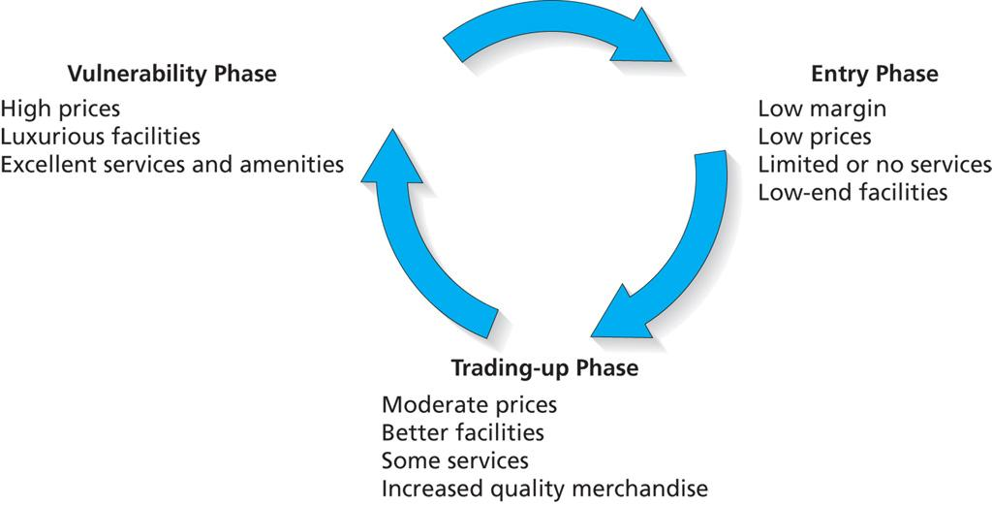
Figure 12.8
The Wheel of Retailing
Copyright © 2013 Pearson Canada Inc.
12-<number>
Notes:
This slide relates to LO #7 of chapter 12.
p. 469
LECTURE NOTES:
Retailing has taken many forms over time. As the economic, social, and cultural factors change, different types of retailers emerge and often squeeze out older, outmoded forms of retailers.
The Wheel of Retailing Theory explains how retail firms change, becoming more upscale as they go through their life cycle. Visually, the Wheel of Retailing is displayed in Figure 12.8.
During the entry phrase, new types of retailers enter the market by offering lower-priced goods with little focus on additional services or the facility itself.
During the trading-up phrase, these retailers gradually improve their facilities, quality and assortment of merchandise, and amenities and also increase prices.
Finally, retailers move up to a high-end strategy with superior facilities, desirable amenities (free gift wrapping), higher operating costs, and of course higher prices. However, this leaves them vulnerable to the entry of new competitors, who undercut their price, offer limited services, and etc., as the entry phrase begins anew.
New ways to sell products are constantly appearing. American Airlines tested the concept of selling services such as Heathrow Express train tickets on London-bound flights, and items from the SkyMall catalog on 165 of its planes.
Still, trading up or upgrading too quickly can spell disaster for a retailer. Walmart attempt to upgrade its clothing line from the basic t-shirt, shorts, and pants collections to brand-name apparel that proved to be out-of-reach of the loyal core user.
While the wheel of retailing helps explain how some retailing forms develop, it doesn’t explain everything. For example, some retailers never trade-up but instead choose to continue to serve their niche as discounters. Still other retailers strategically choose to begin their life as upscale specialty stores, though the sometimes choose to open “sister” stores at the lower end of the price spectrum (as was the case when Gap Stores chose to open Old Navy).

Slide 51
BAB235 In-class Activity - Group
In groups research on the early days of McDonalds, Wendy, Tim, Burger King and KFC in terms of prices, service, restaurant seating etc. How has the wheel of retailing been exemplified in the fast-food industry? (As these restaurants continue to upscale, bare-bone entrants such as A&W, Rally’s and White Castle can enter the market.)What are their competitive advantages Discuss and present to the class.
Copyright © 2013 Pearson Canada Inc.
15-<number>

Slide 52
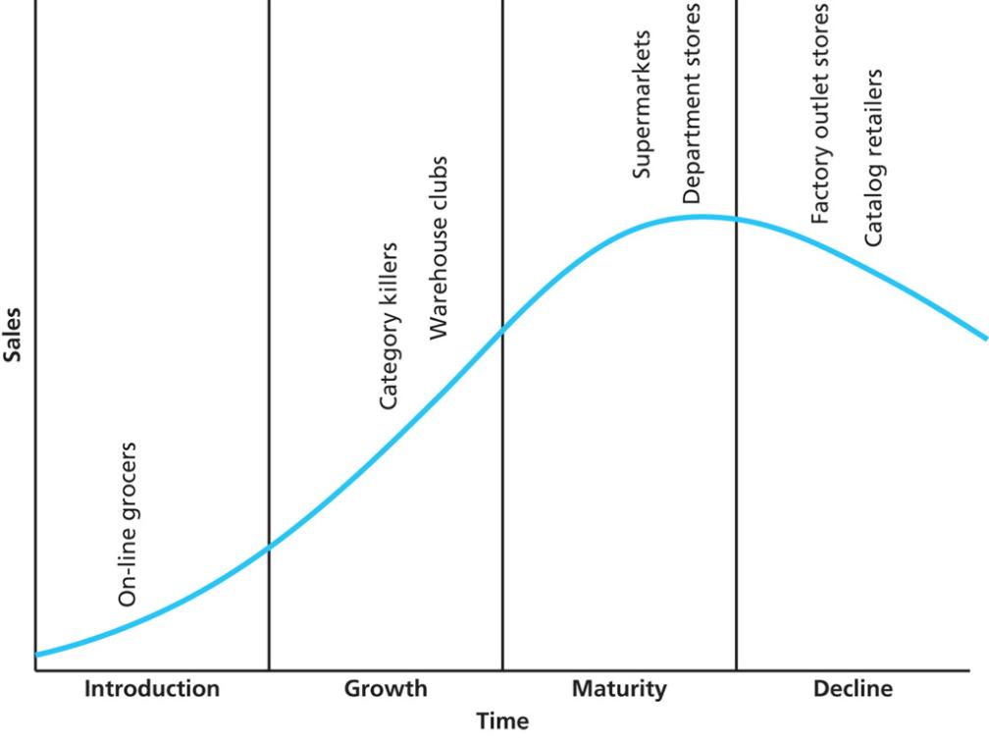
Figure 12.9
The Retail Life Cycle
Copyright © 2013 Pearson Canada Inc.
12-<number>
Notes:
This slide relates to LO #7 of chapter 12.
p. 470
LECTURE NOTES:
Similar to the product life cycle, retail organizations and forms can be characterized as following a life cycle. Retailers are born, grow, mature, and eventually die or become obsolete.
In the Introduction Stage, the new retailer is typically an aggressive entrepreneurs who takes a unique approach to doing business. While this may mean that they use technology or some other factor to offer low priced goods, it could also mean that the retailer is distributing goods in an innovative fashion, or offering a distinctive product assortment of some type. Internet grocery stores such as Netgrocer are still in the introduction stage. While some retailers and forms of retail die without ever getting past the introduction stage, many progress to the next stage, growth.
Businesses that make it to the Growth stage are accepted by at least a segment of consumers, and experience strong sales growth. However, more competitors enter the marketplace, and the original entrepreneur typically responds by expanding its product offerings. Retailers may also open more outlets, though this often cuts into profits due to the large investment in new buildings and fixtures.
Once in the Maturity stage, the retailer faces multiple competitors as the unique idea of the originating firm is copied by others to form an entire industry. As a result, profits decline as the firm loses its uniqueness and competitors resort to price-cutting. Often the industry over expands, placing even more pressure on the retailers at this stage.
New products are often offered in an effort to entice new consumers to the firm.
Other firms find it necessary to merge with a competitor in order to survive. How many of you know that Sears merged with Kmart a few years back?
Yet another survival strategy involves downsizing, in which unprofitable stores are closed or entire divisions are sold off. Prior to merging with Sears, Kmart implemented a downsizing strategy. As another example, Federated Department Stores became Macy’s Inc. and combined with its various department stores under two brand names: Macy’s and Bloomingdales, while less successful chains such as Stern’s Filene’s, and even Marshall Field’s – a veritable retail institution in Chicago – were closed.
During the Decline phase, a retailer becomes obsolete as new and superior ways of doing business emerge. For example, catalog retailers such as Service Merchandise and McDade & Co. exemplify a form of retailing that is all but extinct. Catalog retailing worked in this fashion: direct mail catalogs were sent to area residents promoting merchandise that could be purchased from a brick and mortar store presence. The catalog store provided consumers with a showroom of floor samples, and access to extensive product catalogs filled with merchandise. When a consumer located an item that he or she wanted, an order was placed at the showroom counter (no mail order deliveries were available). This required that a clerk write the order on a sales form, then physically locate the item in the back warehouse. Once located, the item was loaded on a conveyor belt and sent around the warehouse to the pick-up area. Consumers took their order form to the register, paid for the merchandise at the register as designated on the order form, then picked up their item(s) in the pick-up area where they were deposited by conveyor belt. Obviously, the catalog retailer has been replaced by mass merchandisers who allow consumers to save time by self-serving. The lower labor costs also result in lower cost items. Thus catalog retailers represent a retail form made obsolete by changing consumer trends and lower-priced alternatives.

Slide 53
Introduction Stage
Introduction Stage, the new retailer is typically an aggressive entrepreneurs who takes a unique approach to doing business.
This may mean that they use technology or some other factor to offer low priced goods, it could also mean that the retailer is distributing goods in an innovative fashion, or offering a distinctive product assortment of some type. Internet grocery stores such as Net grocer are still in the introduction stage. . While some retailers and forms of retail die without ever getting past the introduction stage, many progress to the next stage, growth
Copyright © 2013 Pearson Canada Inc.
15-<number>

Slide 54
Growth stage
  Growth stage are accepted by at least a segment of consumers, and experience strong sales growth. However, more competitors enter the marketplace, and the original entrepreneur typically responds by expanding its product offerings. Retailers may also open more outlets, though this often cuts into profits due to the large investment in new buildings and fixtures.
Copyright © 2013 Pearson Canada Inc.
15-<number>

Slide 55
Maturity stage
Maturity stage, the retailer faces multiple competitors as the unique idea of the originating firm is copied by others to form an entire industry. As a result, profits decline as the firm loses its uniqueness and competitors resort to price-cutting. Often the industry over expands, placing even more pressure on the retailers at this stage
Copyright © 2013 Pearson Canada Inc.
15-<number>

Slide 56
    Strategies to remain in maturity
    New products are often offered in an effort to entice new consumers to the firm.
    Other firms find it necessary to merge with a competitor in order to survive. How many of you know that Sears merged with Kmart a few years back?
    Yet another survival strategy involves downsizing, in which unprofitable stores are closed or entire divisions are sold off. Prior to merging with Sears, Kmart implemented a downsizing strategy. As another example, Federated Department Stores became Macy’s Inc. and combined with its various department stores under two brand names: Macy’s and Bloomingdales, while less successful chains such as Stern’s Filene’s, and even Marshall Field’s – a veritable retail institution in Chicago – were closed.
Copyright © 2013 Pearson Canada Inc.
15-<number>

Slide 57
Decline phase
  Decline phase, a retailer becomes obsolete as new and superior ways of doing business emerge. For example, catalog retailers such as Service Merchandise and McDade & Co. exemplify a form of retailing that is all but extinct.
  Catalog retailing worked in this fashion: direct mail catalogs were sent to area residents promoting merchandise that could be purchased from a brick and mortar store presence.
  What are some examples of retail stores that declined?
Copyright © 2013 Pearson Canada Inc.
15-<number>

Slide 58
The catalog store provided consumers with a showroom of floor samples, and access to extensive product catalogs filled with merchandise.
When a consumer located an item that he or she wanted, an order was placed at the showroom counter (no mail order deliveries were available).
This required that a clerk write the order on a sales form, then physically locate the item in the back warehouse. Once located, the item was loaded on a conveyor belt and sent around the warehouse to the pick-up area.
Copyright © 2013 Pearson Canada Inc.
15-<number>

Slide 59
Consumers took their order form to the register, paid for the merchandise at the register as designated on the order form, then picked up their item(s) in the pick-up area where they were deposited by conveyor belt.
Obviously, the catalog retailer has been replaced by mass merchandisers who allow consumers to save time by self-serving.
The lower labor costs also result in lower cost items. Thus catalog retailers represent a retail form made obsolete by changing consumer trends and lower-priced alternatives.
Copyright © 2013 Pearson Canada Inc.
15-<number>

Slide 60
The Evolution Continues:
What’s “In Store” for the Future?
Factors motivate retail innovation
  The changing economy
  Demographics
    Convenience for working consumers
    Recognize ethnic diversity
  Technology
    Point-of-sale (POS) system
    Perpetual inventory unit control system
    Automatic reordering system
  Globalization
Copyright © 2013 Pearson Canada Inc.
12-<number>
Notes:
This slide relates to LO #7 of chapter 12.
p. 471 – 473

Slide 61
Amazon go
https://www.amazon.com/b?ie=UTF8&node=16008589011
What is the implication of this new technology on retailing business?

Slide 62
Ethical Problems in Retailing
Shrinkage problems may stem from customers or employees
  Shoplifting
  Employee theft
  Retail borrowing
Ethical treatment of customers
  Not discouraging certain types of customers from shopping
  Not selling harmful products to at risk groups
Copyright © 2013 Pearson Canada Inc.
12-<number>
Notes:
This slide relates to LO #7 of chapter 12.
p. 473 - 474
LECTURE NOTES:
Retailers experience ethical problems with both their customers and employees. Losses due to shrinkage are a growing problem. Shrinkage occurs due to shoplifting, employee theft or merchandise damage, or retail borrowing.
Shoplifting has increased substantially in recent years and accounts for 35% of all shrinkage. In fact, shoplifting is often an organized criminal activity in which thieves take various measures to evade security sensors. Items are then easily sold via E-bay.
Employee theft of both merchandise and cash represents a second form of shrinkage. While some employees unconsciously take pens from work home in their pocket and forget to bring them back to work, the real damage comes from systematic, planned efforts to steal from the store. Theft of store gift cards is common, as is “sweethearting”, a practice in which a cashier consciously undercharges or provides a cash refund to a friend. In extreme instances, unethical cashiers allow friends to walk away with merchandise without paying anything.
Retail borrowing occurs when nondefective products are returned and a refund is received for items that have already been used for the purpose for which they were bought. Liberal return policies of many merchandisers have allowed consumers to take advantage of “the system” in this fashion. Retail borrowing often occurs with special occasion clothing (suits, cocktail dresses for weddings, etc.). Unfortunately, sometimes this practice damages the merchandise in a manner that it makes unsuitable for resale, costing the retailer and manufacturer money.
Ethical treatment of customers: Some retailers treat their customers in an unethical manner, particularly when “snobbery” on the part of clerks discourages people who appear socially or economically disadvantaged from shopping. While preventing these individuals from entering the store outright is illegal, making snide comments, delaying service to the individual, or demeaning them by demanding to see their money upfront it not. Obviously, such treatment is unethical, though retail management may turn a blind eye to these tactics when they feel they are helpful in protecting the store’s image.
Some individuals believe that retailers have an obligation not to sell products that can be harmful to at risk groups. Retailers are obligated to follow the law, meaning that they must card those who purchase alcohol and tobacco products and follow appropriate regulations for the purchase of firearms and drug products. But there are limits to what retailers can be realistically asked to do. Expecting retailers to police the purchase of every item that could be potentially dangerous or harmful (particularly if misused) is irrational.

Slide 63
VIII. Understand how we classify retailers
Copyright © 2013 Pearson Canada Inc.
12-<number>
Notes:
This slide relates to LO #8 of chapter 12.

Slide 64
From Mom-and-Pop to Super Walmart: How Marketers Classify Retail Stores
Several classification methods exist
  Classify by what they sell
    Merchandise mix
  Classify by level of service
  Classify by merchandise selection
    Merchandise assortment
    Merchandise breadth: Number of diff pdt lines availiable.
    Merchandise depth: Variety of choices availiable within specific pdt line
Copyright © 2013 Pearson Canada Inc.
12-<number>
Notes:
This slide relates to LO #8 of chapter 12.
p. 475 - 476
LECTURE NOTES:
Marketers classify retail stores in a variety of ways. This is important because retailers often benchmark their own performance relative to those against whom they compete.
Retailers classified by what they sell are categorized according to their merchandise mix. The merchandise mix is the total set of products offered for sale by a retailer, including all product lines sold to all consumer groups. The Census of Retail Trade classifies all retailers by the North American Classification System; retailers could use this system to identify the specific competitors against whom they can be benchmarked.
Unfortunately, many retailers are experimenting with different merchandise mixes which makes it much more difficult to find true direct comparisons.
For example, combination stores offer consumers food and general merchandise in the same store, while supercenters such as Walmart Supercenters are large combination stores that carry general merchandise, groceries, pharmaceuticals, and sometimes services such as banking, hair styling, etc.
Since retailers differ in the amount of service they provide to consumers, this represents another possible method of classification. Self-service retailers provide virtually no service whatsoever; consumers browse aisles and take the product off the shelf without assistance. Most chain grocery stores are examples. By contrast, full-service retailers such as bridal shops offer extensive help from trained assistants who pay a great deal of personal attention to the shopper. Additional services are also offered, such as alteration, credit, gift-wrapping, and the like. Limited-service retailers fall between these two extremes. Such stores may offer credit service and merchandise return services but little else; the majority of shopper selection is done without assistance Walmart, for example, has clerks in the electronics department to help those interested in purchasing HD TVs or other items.
The final way to classify retailers is by merchandise selection.

Slide 65
Major Types of Retailers
Convenience stores
Supermarkets
Box stores
Specialty stores
Leased departments
Discounts stores
  General merchandise discount stores
  Off-price retailers
  Warehouse clubs
  Factory outlet stores
Department stores
hypermarkets
Copyright © 2013 Pearson Canada Inc.
12-<number>
Notes:
This slide relates to LO #8 of chapter 12.
p. 476 - 479

Slide 66
IX. Describe the more common forms of nonstore retailing including B2C e-commerce
Copyright © 2013 Pearson Canada Inc.
12-<number>
Notes:
This slide relates to LO #9 of chapter 12.

Slide 67
Nonstore Retailing
Refers to any method used to complete an exchange with a product end user that does not require a customer visit to a store
Direct selling
  Door-to-door sales
  Parties and networks
  Multilevel or network marketing
Automatic vending
B2C e-commerce
Copyright © 2013 Pearson Canada Inc.
12-<number>
Notes:
This slide relates to LO #9 of chapter 12.
p. 479 - 485
LECTURE NOTES:
Nonstore retailing efforts are increasingly successful at reaching those consumers who don’t like shopping at malls or retail venues, or whose time commitments limit when they can shop. Nonstore retailing describes any method used to complete an exchange with a product end user that does not require a customer visit to the store. One type is direct selling. It may include door-to-door sales, parties and networks, and multilevel networks. Automatic vending and B2C E-commerce represent the other key forms of nonstore retailing.
Door-to-door selling is still popular in some countries, but is rarely used anymore in the U.S and Canada.
Pampered Chef is an example of a firm that sell products via the party plan system, in which a company representative makes a sales presentation to a group of people who have gathered at the home of a friend who typically provides food and often alcoholic beverages. Attendees often get caught up in the spirit of the event and buy things they wouldn’t normally purchase.
Multilevel networks and activities work for firms such as Amway, in which a master distributor recruits others to become distributors of the firms’ products as well, thereby ensuring him or herself a commission on every sale made by those he or she recruits. A benefit of this system is that it can sometimes reach consumers who belong to tightly knit groups when a member of the group is one of the recruits.
However, some network systems are illegal and are properly referred to as illegal pyramid schemes. These promise large profits from recruiting others to join the program rather than from any real investment or sale of goods, and typically require that those at the bottom of the pyramid pay a fee to advance to the top where they can allegedly benefit from others who are recruited. Other pyramid schemes disguise their true nature by requiring members to buy large costly quantities of merchandise upfront.

Slide 68

Automatic Vending
Automatic vending
  Usually best suited to low-cost convenience goods
  Offers many benefits to consumers and marketers
Japanese vending machines
Copyright © 2013 Pearson Canada Inc.
12-<number>
Notes:
This slide relates to LO #9 of chapter 12.
p. 481
LECTURE NOTES:
When consumers can’t or won’t visit the store, automatic vending machines serve as a tried-and-true method of selling convenience goods. Vending units require relatively little space and personnel to maintain, and offer the advantage of providing products when and where it is convenient for consumers to buy. Lately it seems as if everything from ice, to fishing bait, to DVDs can be purchased from vending units. This is particularly true as touchscreen technology and credit cards make it possible to purchase more costly items.
Japan has the highest number of automatic vending machines per capita, and marketers have developed some very creative vending opportunities. Let’s visit the website on this slide and take a look.
WEBSITE NOTES:
This site offers 14 examples of creative vending machines that sell everything from traditional beverages like Coca-Cola to non-traditional items such as sneakers. While Coca-cola video is not functioning, the 36 second “egg” video demonstrates

Slide 69
B2C’s Effect on Retailing’s Future
Virtual channels are unlikely to replace traditional ones
Stores must continue to evolve to lure shoppers away from computers
  In destination retailing, consumers will visit stores for the total entertainment experience
Visit Mall of America
Copyright © 2013 Pearson Canada Inc.
12-<number>
Notes:
This slide relates to LO #9 of chapter 12.
p. 484 - 485
LECTURE NOTES:
Despite the growth of B2C e-commerce, it is unlikely that e-commerce will ever completely replace physical store locations. Even in banking, consumers seem to value the choice of being able to go to an actual location for transactions, as well as being able to shift funds or pay bills over the Internet. While many retailers would prefer to avoid the cost and hassle of staffing physical stores, it doesn’t seem to be in the cards anytime soon. However, more and more brick-and-mortar retailers are finding it necessary to entertain consumers as part of the shopping experience in order to lure them away from their computers. One destination retailers is Cabalas in Forth Worth Texas. This store enhances the shopping experience by maintaining huge freshwater aquariums containing a variety of American sporting fish. They also offer a wildlife museum of trophy deer heads and various wildlife animals.
WEBSITE INFORMATION:
Mall of America, one of the largest destination retailing centers, features an aquarium, a flight simulation, an 18-hole miniature golf course, a comedy club, and a massive four-story Lego playground. Click the “Attractions Button” to see the various offerings.

Slide 70
X. Understand the importance of store image to a retail positioning strategy and explain how a retailer can create a desirable image in the marketplace
Copyright © 2013 Pearson Canada Inc.
12-<number>
Notes:
This slide relates to LO #10 of chapter 12.

Slide 71
Developing a Store Positioning Strategy: Retailing as Theater
Shopping is part buying, part entertainment, part social outlet
The line between retailing and entertainment is blurring
A store must create an attractive store image to both attract consumers and stand apart from the competition
Copyright © 2013 Pearson Canada Inc.
12-<number>
Notes:
This slide relates to LO #10 of chapter 12.
p. 485
LECTURE NOTES:
Stores need to position themselves in a manner that demonstrates their competitive advantage over other stores while attracting the interest and attention of the consumer.
Many retailers recognize that there is a “theatre” aspect to what they do. Shoppers represent the audience to be entertained, while the store design sets the stage. When salespeople – the equivalent of actors in retail – are added to the mix, the scene is set. Employee uniforms often serve as costumes . . . For example, consider the referee shirts worn by Foot Locker employees.
Merchandising displays can be very creative, making the buying experience less about buying and more about having an experience. It’s clear that the line between entertainment and retail is blurring.

Slide 72
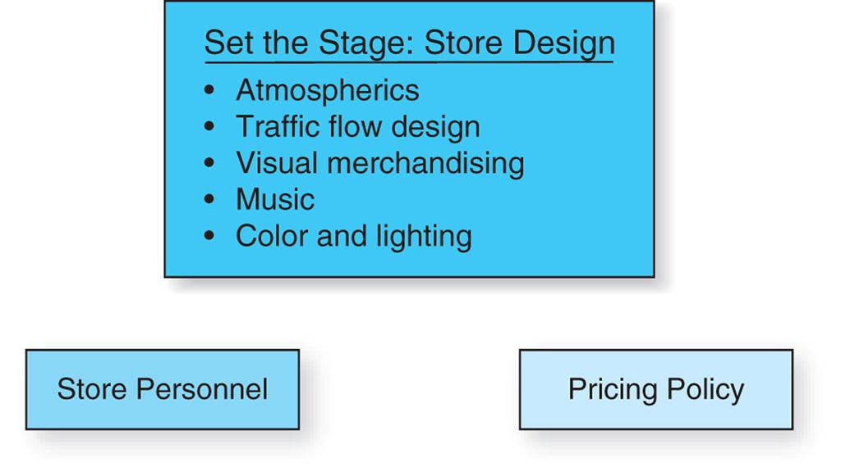
Figure 12.11
Elements of a Store Image
Design_x000b_Portfolio
Copyright © 2013 Pearson Canada Inc.
12-<number>
Notes:
This slide relates to LO #10 of chapter 12.
p. 486
LECTURE NOTES:
A store’s image reflects the way the marketplace perceives a retailer relative to the competition. Shoppers may use terms such as exciting, old-fashioned, or tacky, for example. Many store design, personnel, and pricing decisions influence consumer’s perception of a given store’s image. Ideally, all of the elements in Figure 12.11 should work together to create a clear, coherent, and consistent image that meets the consumers’ expectations of what the shopping experience should be.
Atmospherics provide critical perceptual cues to consumers regarding the “feel” of the retail environment. Atmospherics include use the use of lighting, scents, sounds, décor and other design elements. Even the materials used in the interior design process can contribute to the atmosphere. For example, a heavy emphasis on wood as part of the design process, particularly if portrayed in a rustic manner, creates an outdoorsy feel to the retail experience. While this is suitable for Bass Pro Shops, such a decision would be disastrous if implemented for Victoria’s Secret.
Visual merchandising refers to the design of all things customers see both inside and outside of the store. Thus the feelings of shoppers are influenced by furnishings, fixtures, the amount of clutter, etc. Upscale stores create more space for sitting areas and dressing rooms. The storefront, or physical exterior of a store along with the marquee (sign that shows the store’s name) are critical in setting consumer’s expectations.
Music, color and lighting all can be manipulated by marketers to create or enhance a mood. Red, yellow, and orange are warm colors which stimulate hunger while blue, green, and violet symbolize elegance and cleanliness.
WEBSITE INFORMATION
A firm specializing in restaurant interior design is linked to this slide. Clicking the PORTFOLIO link will launch a series of photos demonstrating various aspects of the firms atmospherics, visual merchandising, color, and lighting.

Slide 73
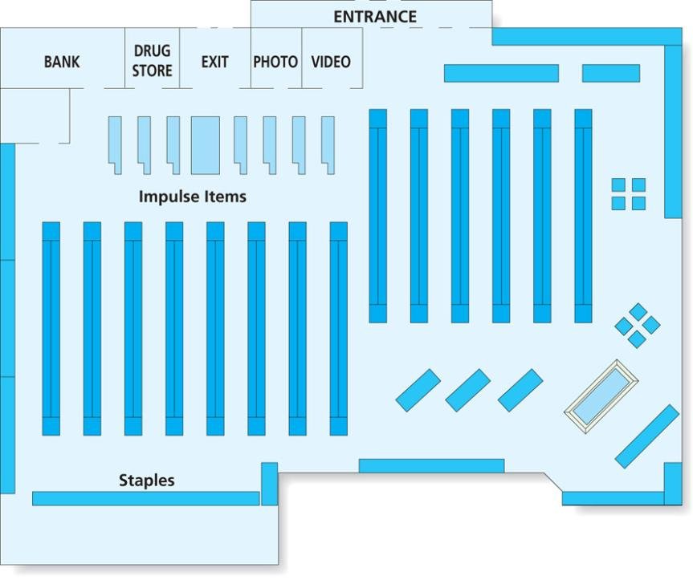
Figure 12.12
Grid Layout
Copyright © 2013 Pearson Canada Inc.
12-<number>
Notes:
This slide relates to LO #10 of chapter 12.
p. 487
LECTURE NOTES:
A store’s layout refers to the arrangement of merchandise in the store, and how shelves, racks, tables, and cash registers are placed. The arrangement of each element is critical for directing the traffic flow, or how shoppers move through the retail environment. For example, many restaurants are arranged so that bar patrons have immediate access to the lounge upon entering the facility without having to pass through the dining area, possibly disturbing diners or presenting obstacles to busy waiters. On the other hand, many stores design layouts that force consumers to walk past as many items as possible in an attempt to prompt impulse buying. Placing staple items and those that are most desirable towards the back of the store is quite common.
A grid layout, such as the one illustrated in Figure 12.12, is common in grocery and discount stores. This type of layout features rows of neatly spaced shelves and decently sized aisles that allow consumers to pass one another easily in the aisle. Department and specialty stores will often use a free-flow layout instead, which is less structured and more conducive to browsing.

Slide 74
Developing a Store Positioning Strategy: Retailing as Theater (ctn’d)
Store personnel
  Should complement a store’s image
  Dress, attitude, and knowledge are important
Pricing policy
  Price points are price ranges of a store’s merchandise
  Price points play a role in establishing its image
  Pricing policy used by a retailer can influence consumers perception merchandise quality.
Copyright © 2013 Pearson Canada Inc.
12-<number>
Notes:
This slide relates to LO #10 of chapter 12.
p. 488
LECTURE NOTES:
Store personnel should exhibit mannerisms and dress that complement the store’s desired image. Uniforms are often employed as one method of complimenting the image. Employee training should address not only product knowledge, but the proper attitude and frame of mind that should be displayed by employees whenever they are “on stage” and dealing with shoppers. This also influences the level of customer service provided. Many businesses encourage a level of service and employee expertise that ultimately results in a competitive advantage for the firm. Whether it’s a grocery store that loads grocery bags in the car for you, or Nordstrom’s, where employees have been known to warm-up customers’ cars on cold days, store personnel and the service they provided are critical elements in the development and maintenance of store image.
Consumers form expectations of price points, or the price ranges they should be expected to pay at a given store based on many factors. For example, slogans, such as “Friends don’t let friends pay retail” imply a lower priced merchandise selection. The frequency and type of sales used by retailers also affects the image of the store, as well as consumer’s behavior. Consumers’ quests for deals over the past few years caused many department stores to offer sales to attract consumers. Unfortunately, this strategy backfired, as consumers became conditioned to shopping ONLY during sales. It should also be remembered that the pricing policy used by a retailer can influence consumers perception merchandise quality.

Slide 75
Developing a Store Positioning Strategy: Retailing as Theater (ctn’d)
Build the theatre: store location
  Types of store locations
    Business districts
    Shopping centers
    Freestanding retailers
    Nontraditional store locations
  Site selection is critical
    “Location, location, location”
Copyright © 2013 Pearson Canada Inc.
12-<number>
Notes:
This slide relates to LO #10 of chapter 12.
p. 488 – 489
LECTURE NOTES:
Retailers can choose to locate their stores in a variety of locations. This is a critical decision, because the key to retailing success is commonly referred to as “Location, location, location.”
Let’s talk a look at the major types of store locations.

Slide 76
Developing a Store Positioning Strategy: Retailing as Theater (ctn’d)
Site selection: choose where to build
  Trade area
  A geographic zone that accounts for the majority of a store’s sales and customers
  Factors considered in site selection
    Site evaluation :traffic flow, number of parking spaces, ease of delivery access
    Age profile: Young families? Older retirees?)
    Community life cycle: New? Stable? In decline
    Mobility:
    Degree of competition
Copyright © 2013 Pearson Canada Inc.
12-<number>
Notes:
This slide relates to LO #10 of chapter 12.
p. 489 - 490
LECTURE NOTES:
Site selection is a critical decision which heavily influences the success of any retailing strategy. The choice of where to locate a new store should reflect the overall growth strategy and be consistent with the firm’s long-term goals. Long-term population patterns, competitor’s locations, and the demographic make-up of the area are all important factors to be considered.
Location planners must also consider how convenient a particular spot is to customer’s in the store’s trade area in addition to the final four factors listed on the slide.
A site evaluation considers specific factors such as traffic flow, number of parking spaces, ease of delivery access, visibility of the location from the street, zoning laws, and the type of signage allowed in a given area.
The age profile of the area (Young families? Older retirees?) and community life cycle (New? Stable? In decline?) are also important.
Finally, the degree of competition must be considered. Fast food restaurants specifically strive to locate in saturated trade areas characterized by high traffic and many stores. On the other hand, Walmart’s strategy seeks to serve understored trade areas where too few stores exist to serve the needs of the population. Over time, certain areas trade areas may become overstored in that too many stores exist for the sales volume available. Those that can’t compete move or close.

Slide 77
Walmart
http://libaccess.senecacollege.ca/login?url=http://fod.infobase.com/PortalPlaylists.aspx?wID=102598&xtid=40685&loid=73129
http://libaccess.senecacollege.ca:2048/login?url=http://fod.infobase.com/PortalPlaylists.aspx?wID=102598&xtid=40685&loid=73139
Copyright © 2013 Pearson Canada Inc.
15-<number>

Slide 78
All rights reserved. No part of this publication may be reproduced, stored in a retrieval system, or transmitted, in any form or by any means, electronic, mechanical, photocopying, recording, or otherwise, without the prior written permission of the publisher. Printed in Canada.
Copyright © 2013 Pearson Canada Inc.
12-<number>

